Slide 1
Our school values.
By the House Captains

Slide 2

Sharing
Sharing is one of the most important things in life because we can’t have everything all to ourselves. We understand it can be hard to share sometimes, especially when it is things we love. But we share lots of things with each other and we don’t even notice, we share our love, time, kindness and our world to everyone! ‘The best way to multiply your happiness is to share it.’

Slide 3
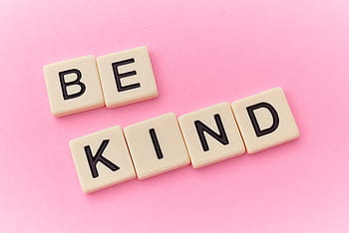
Acceptance
We accept that everyone is different and we all understand their likes and dislikes. We also accept people from all around the world and their race and religion. It is important to know that it is not about looks, but about personality, we try to make everyone feel welcome and accepted once they join our school. We accept all the school values and encourage others to follow them, because they can lead us and encourage us to do better. ‘Acceptance is the road to all change.’

Slide 4
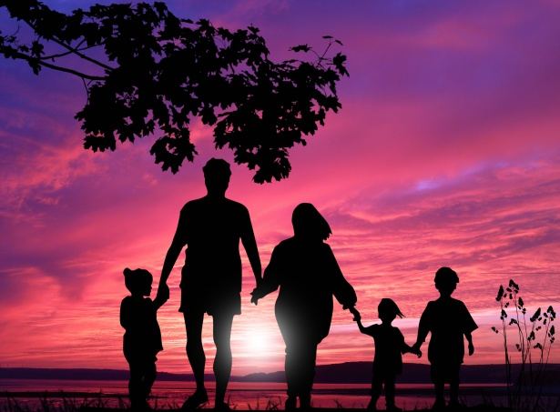
Family
Our school is one big family, we are there for each other, and support everyone. We celebrate our difference and talents every week at celebration assembly, because we are a community. Being together is important because we get to know each other better, and grow as a community. As a family we follow all the values because we believe that they are important. Family means friendship, and that means we are there for each other. ‘Families are like branches in a tree. We grow in different directions, yet our roots remain as one.’

Slide 5
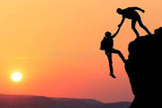
Trust
Trust is a thing that we should do, but not all the time, because if we do it all the time, not everything will be private, even if we want it to be. We should trust our parents, and family members as well as ourselves and friends. We trust each other with secrets and with things we own and that God loves us and that he will never leave us and always guide us to the right path in life. You need to be careful with trust because it is important and can easily be broken. ‘Trust takes many years to build, a few seconds to break, and forever to repair.’

Slide 6

Honesty
We show honesty by telling the truth and making the right choices. Being honest helps us to grow up and have a very very bright future . We should be honest at the start because God will always forgive us and give us a second chance. When we do make mistakes we confess our sins to the priest at the sacrament of reconciliation. ‘Honesty is the fastest way to prevent a mistake from turning into a failure.’

