Slide 1
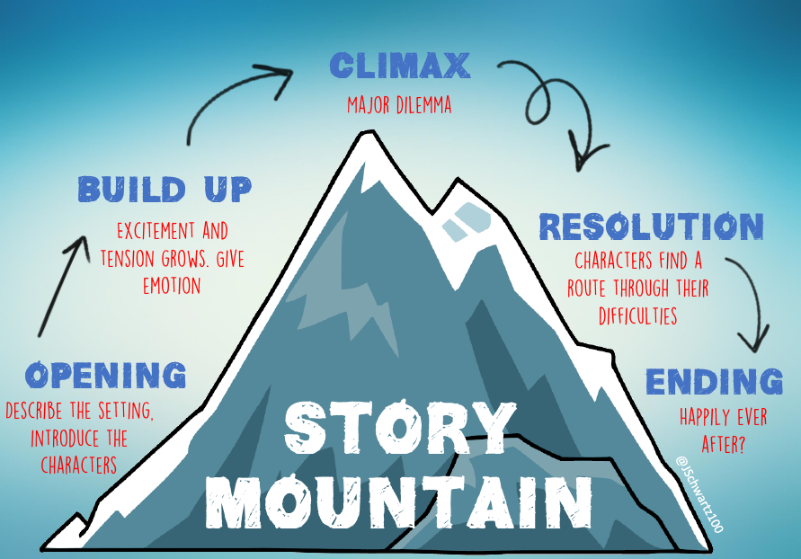
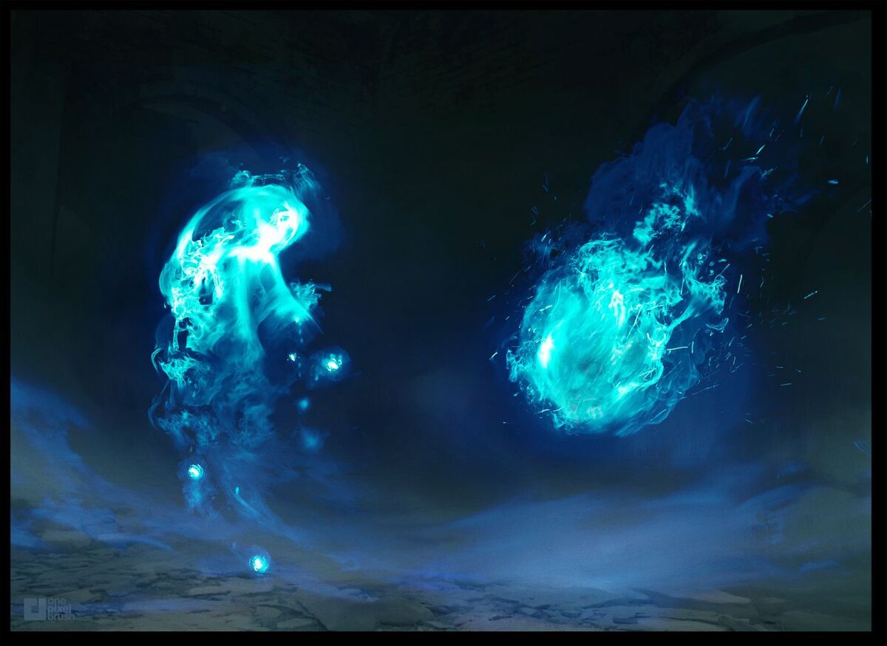
The Wisp - Narrative
ENGLISH KNOWLEDGE ORGANISER
ESSENTIAL VOCABULARY/WORD BANK
Wisp | a thin strip or fragment
Refugee | people who have fled war, violence, conflict or persecution and have crossed an international border to find safety in another country
etched | imprinted vividly on someone's mind or memory
quivered | to shake slightly, often because of strong emotion
ancient | belonging to the very distant past and no longer in existence; Very old.
Audience
Peers in the form of a class book
Co-ordinating conjunctions
For (instead of because) And Nor But Or Yet So Idris picked up the wisp, for he was curious. Idris smiled with delighted and felt a glimmer of hope. He knew exactly what it was, so he gentlied it up.
Final Outcome
Narrative adaptation, detailing a visit made by the wisp.
Simile and metaphor
Simile: the comparison of one thing with another thing of a different kind, using like or as. Metaphor: a figure of speech in which a word or phrase is applied to an object or action to which it is not literally applicable.
Fronted adverbials
MUST BE FOLLOWED BY A COMMA Afterwards, Rarely, Every second, Mysteriously, Bravely, Awkwardly, Wherever they went,
Simple sentence, compound sentence or complex sentence?
Simple: Idris picked up the wisp. Compound: Idris picked up the wisp and he held it in his cold hands. Complex: Without hesitation, Idris edged towards the wisp.
Planning a narrative
Opening Build up Climax Resolution Ending
Non-negotiables for this piece of work
Fronted adverbials A plot that follows your story mountain Adjectives to describe your characters and the setting FANBOYS Year 5/6 words A variety of sentence lengths I have proof read my work for spelling and punctuation errors!
‘As a family we live, love, learn and celebrate with Jesus.’

Slide 2
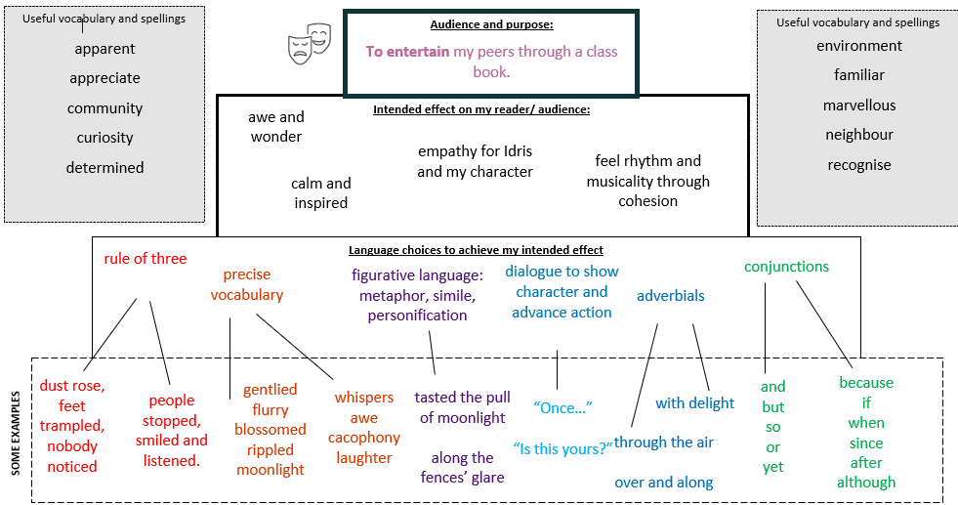
The Wisp - Narrative
ENGLISH KNOWLEDGE ORGANISER
‘As a family we live, love, learn and celebrate with Jesus.’

